Slide 1
Multi-Modal Deep Learning for Alzheimer’s Disease Diagnosis from MRI and Clinical Data
Student: Yifei Wang
Instructor: Dr Grace Ugochi Nneji

Slide 2
Introduction
01

Slide 3
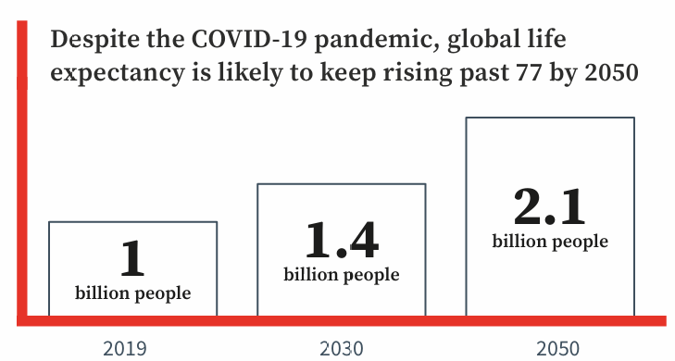
Background
As our societies age, the number of people living with dementia across the world is expected to rise from 55 million in 2019 to 139 million in 2050, according to the WHO2. The costs associated with dementia are also expected to more than double from US$1.3 trillion per year in 2019 to $2.8 trillion dollars by 2030.
Therefore, it is necessary to design an multimodal SE-CNN integrates MRI/clinical data with attention mechanisms, enabling early MCI detection (2.1-year diagnostic delay reduction) while ensuring accuracy and efficiency.
Figure 1:Estimated number of people aged 60 or older according to the WHO

Slide 4
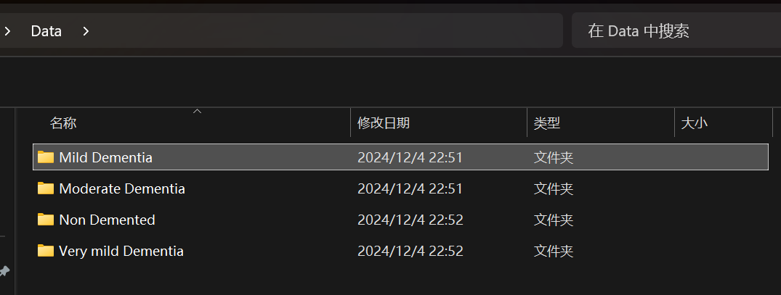
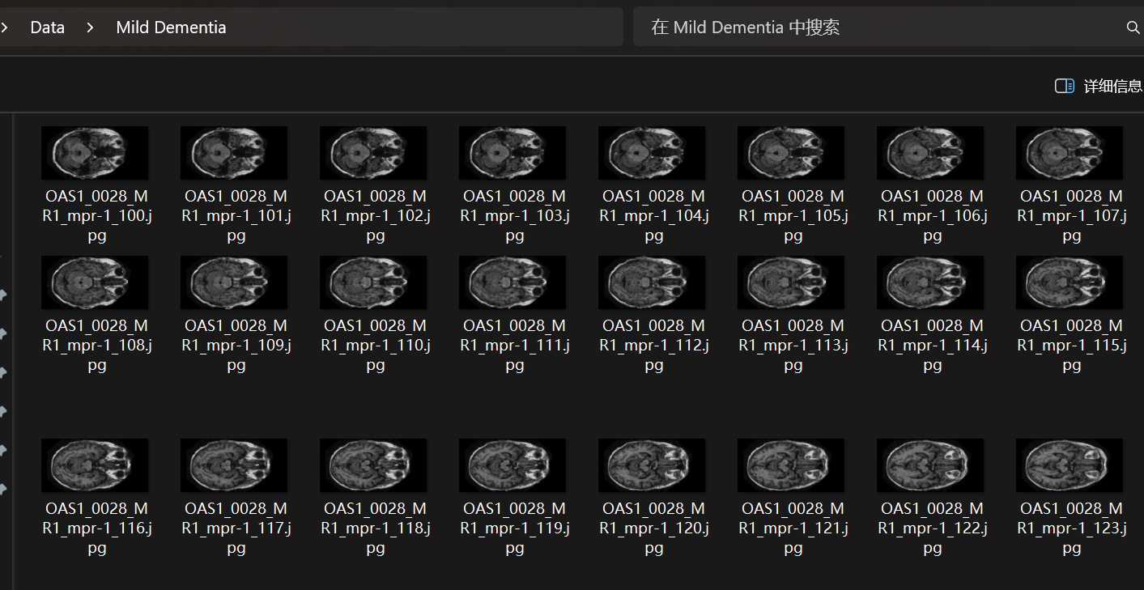
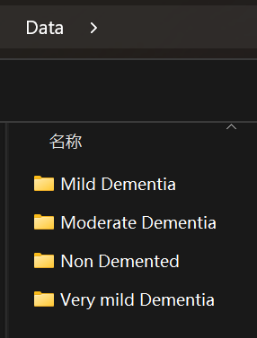
Database

Slide 5
03
Problem and Result

Slide 6
Problem and Solution
Solved by
Imbalanced Dataset
Data Augmentation
The dataset is highly imbalanced: The data in label Non Demented (78%) vastly outweighs data in label Moderate Dementia (0.5%).
Strategies include oversampling minority classes, Conduct extraction training on some data of each label and class-weighted loss to address bias toward majority groups.

Slide 7
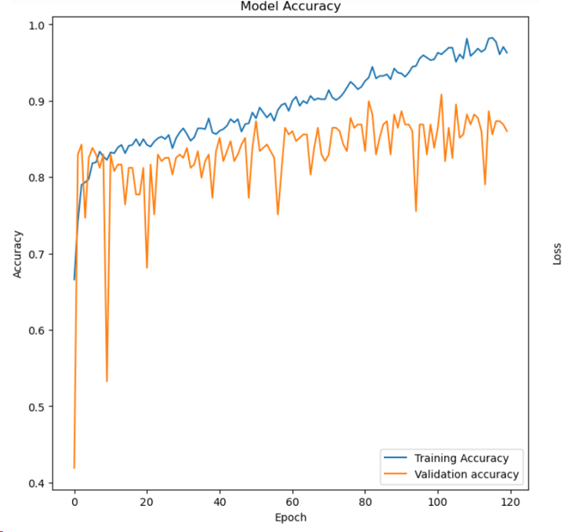
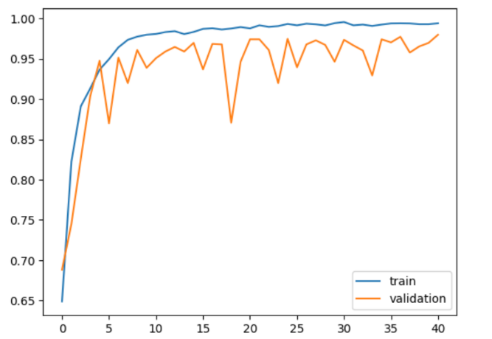
Problem and Solution
Solved by
Low Generalization Ability
Attention mechanism
Concerns arise regarding the model's capability to perform well on unseen data, indicating potential limitations in its ability to generalize beyond the training dataset.
By introducing the SE attention mechanism to make the model focus on the key parts of the MRI, the training accuracy is significantly improved

Slide 8
03
Approach and Result

Slide 9
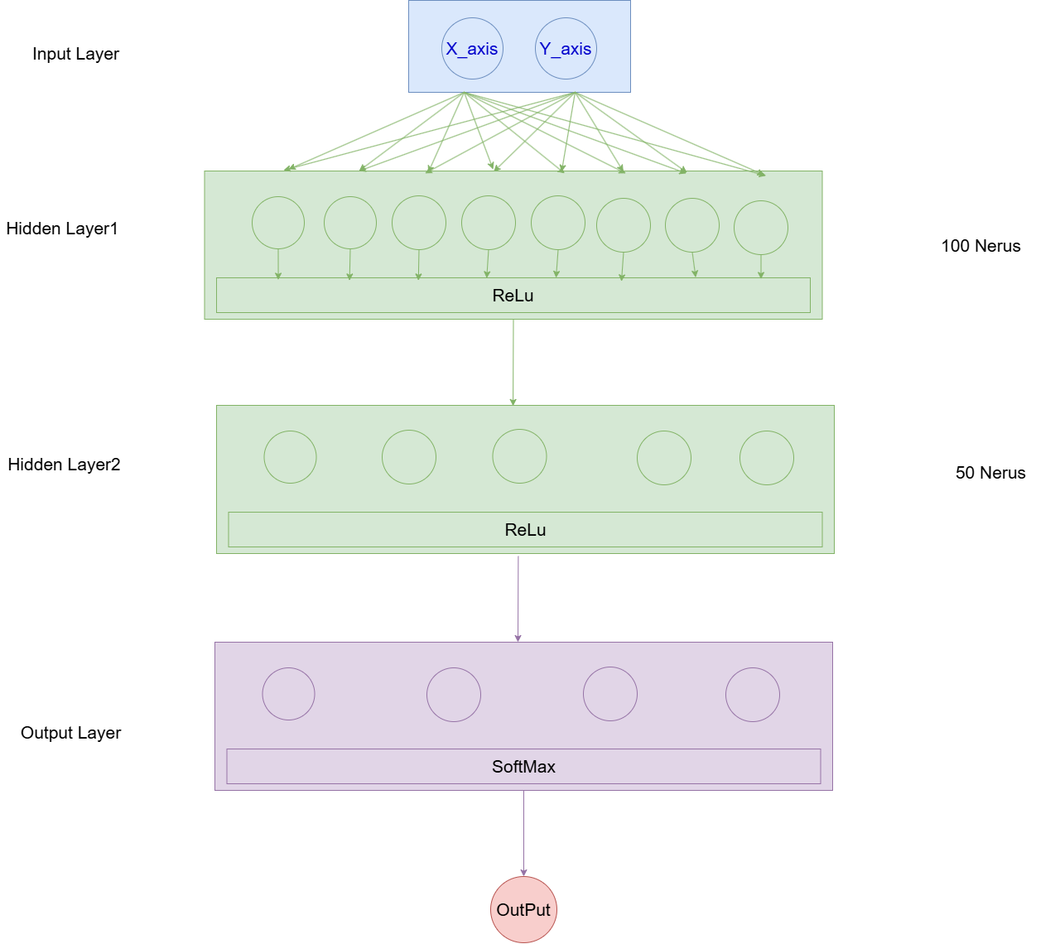
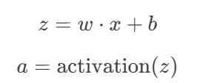
Simple-MLPClssifier
The model employs one input layer, two hidden layer and one output layer.
This model have two hidden layer, The first hidden layer have 100 nerus and the second hidden layer have 50 nerus.
The key part is Forward Propagation: Data flows from input to output layer. Each neuron computes:
This neural network is capable of analyzing clinical data and improving the overall accuracy in multimodal models
Figure 2:The model architecture of the simple-MLP

Slide 10
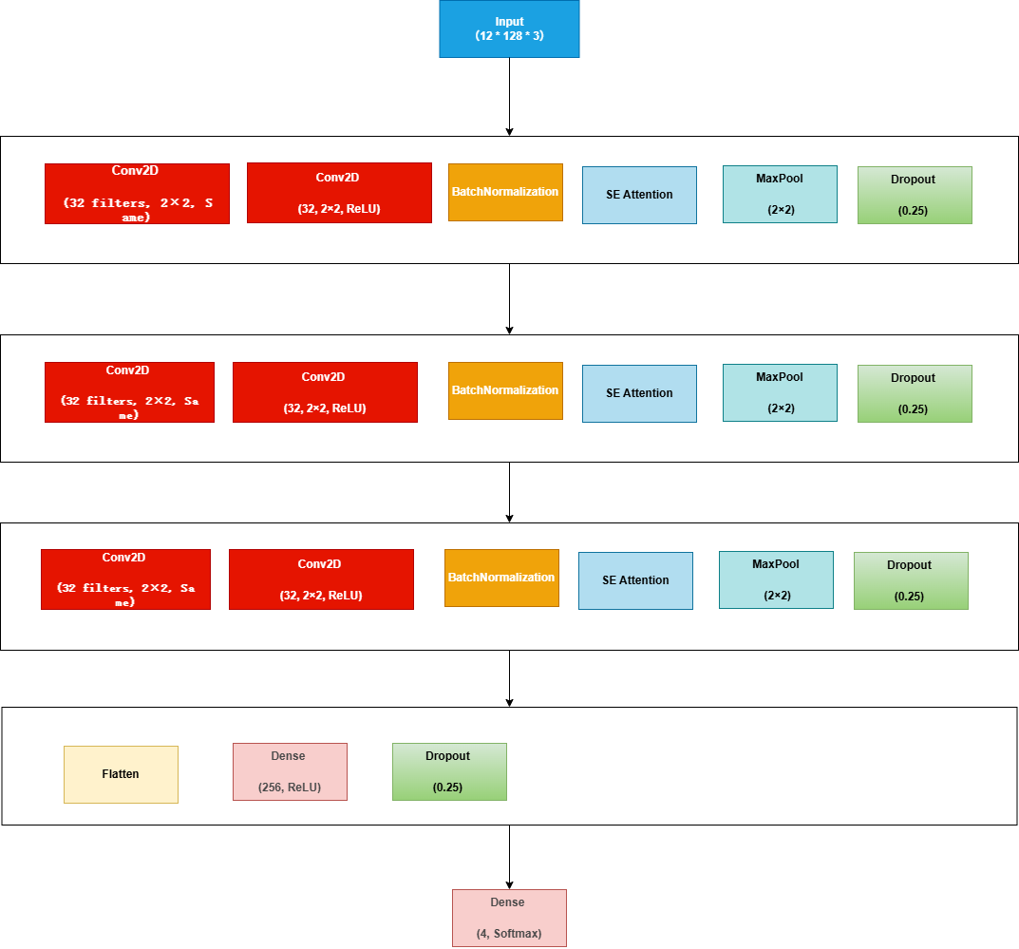
CNN-AD
The CNN_AD structure is inspired by the VGG architecture.
It uses two (3x3) CNNs followed by MaxPooling, with BatchNomalization for complex feature learning.
𝑦𝑖=ℎ(𝑥𝑖)+𝐹(𝑥𝑖,𝑊𝑖)
𝑥𝑖+1=𝑓(𝑦𝑖)
It aim to to enhance early and accurate Alzheimer's diagnosis by integrating MRI scans using CNN-AD framework, dynamically prioritizing critical biomarkers through attention mechanisms
Figure 3:The model architecture of the CNN-AD

Slide 11
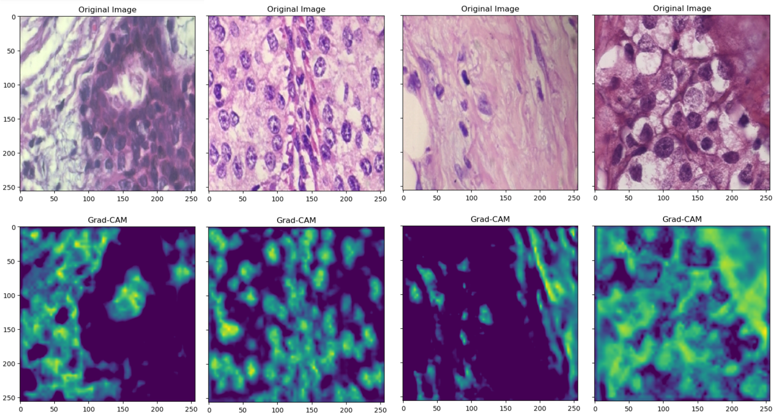
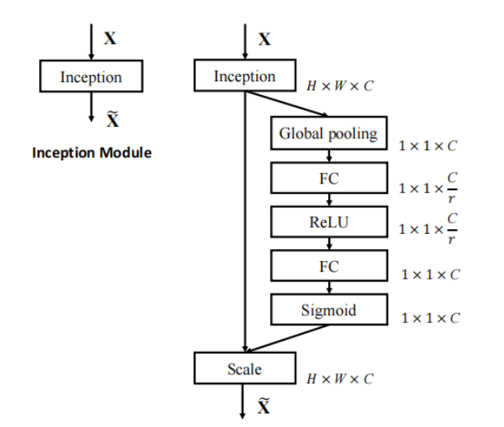
SE attention block
CBAM: Convolutional Block Attention Module, it combining Channel Attention Module (CAM) for channel-wise feature weighting and Spatial Attention Module (SAM) for spatial feature weighting.
First row: original medical images of breast tissue slices.
Second row: accompanying Grad-CAM heatmaps shows below.
Yellow/Green: crucial areas higher model attention and
Blue/Black: as less important.
Figure 4:The architecture of the SE attention mechanism

Slide 12
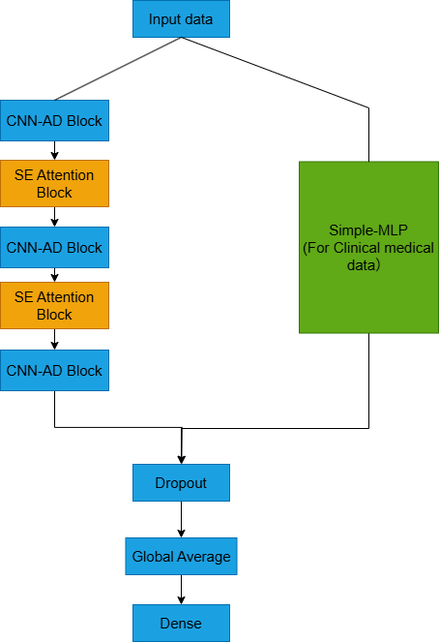
Proposed Structure
The Multimodal model mainly have two pathways.
First branch: CNN_AD and SE Attention blocks loops for deep learning and attention crucial features.
Second branch: Simple-MLP path implement the learning of clinical medical data and the extraction of features
Enhances feature extraction, attention, and robustness. Effective for complex classification tasks.
Figure 5:The architecture of the MRI and Clinical medical data multimodal

Slide 13
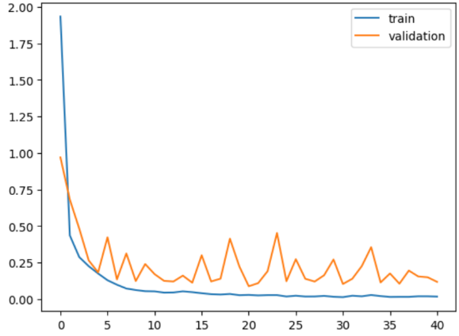
Accuracy and Loss
0.9893
0.113
Test accuracy
Test Loss
Figure 6:The accuracy and loss of the MRI and Clinical medical multimodal

Slide 14
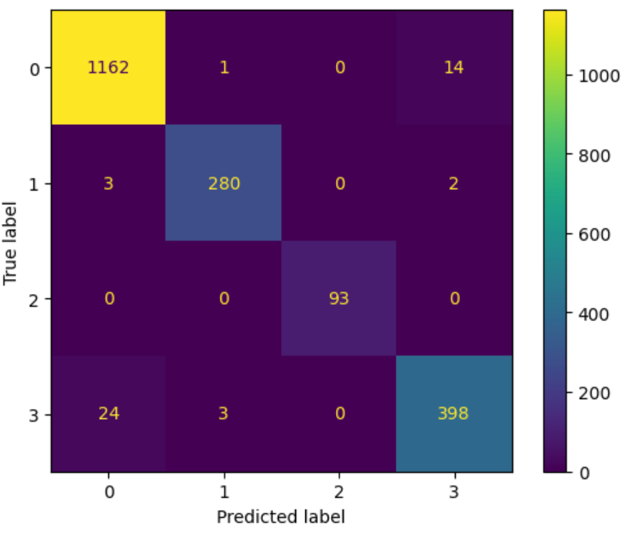
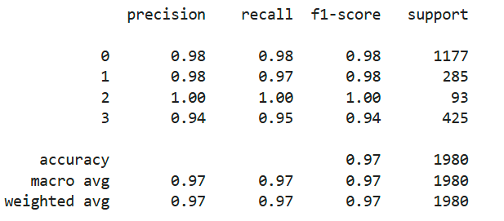
Detail of Prediction Result
Figure 7: The confusing Matrix
Figure 8: The Training Result

Slide 15
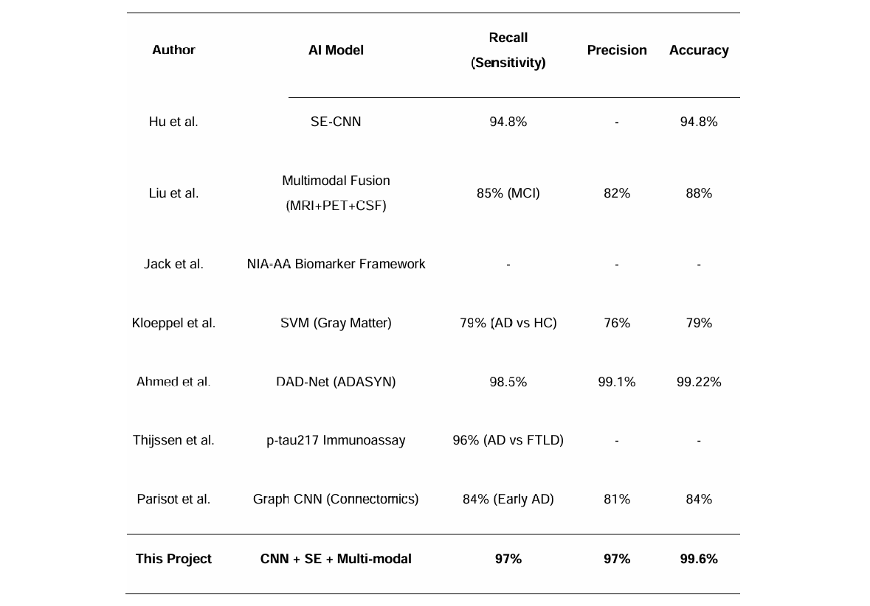
Comparison
Figure 9: The Comparison Table

Slide 16
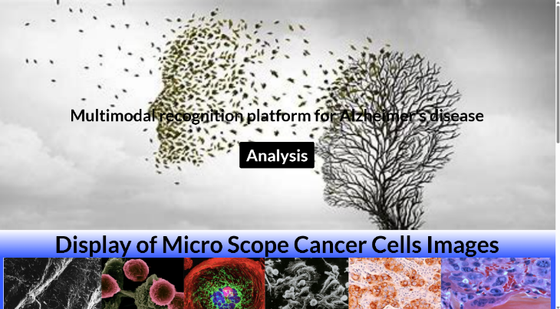
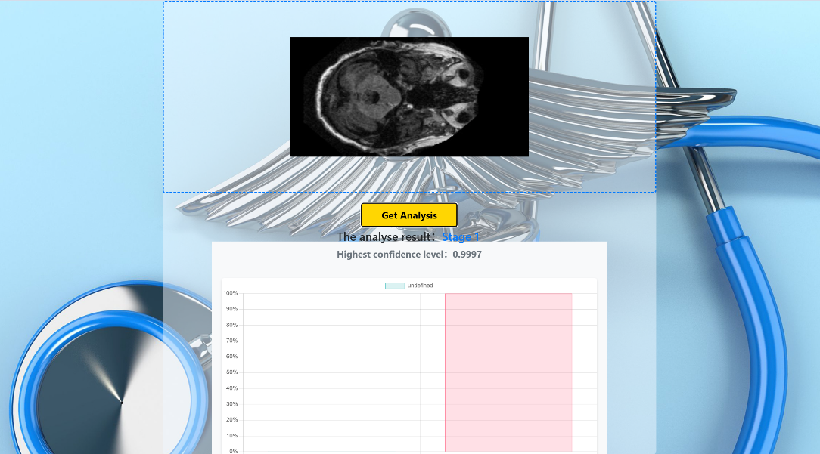
Demonstration using website
Figure 10: The website UI design
Notes:
Shows the record video of UI demo.

Slide 17
04
Conclusion

Slide 18
Limitations
Lack of Dataset
A total of 5.6GB data were collected. But the data of Clinical Medical data only have 17KB.
Computation ability
Considering the limited resources, by using the operator acceleration algorithm, a highly accurate model can be trained with a small number of iterations.
Lack of Adaptability
Due to the limitation of model, the model only can analyze MRI and Clinical medical Data.
Communication with professor
Without input from medical professionals, it's challenging to confirm whether the model's attention distribution is relevant to pathologies.

Slide 19
Future Work
Optimize Model Performance: Refine architecture, explore advanced algorithms, and experiment with data augmentation.
Enhance Generalizability: Validate across diverse datasets and medical contexts for robustness.
Validate Real-World Performance: Collaborate with healthcare institutions for clinical trials and practical validation.

Slide 20
Conclusion
This study proposed a multimodal SE-CNN framework for the diagnosis of Alzheimer's disease. By citing attention and combining MRI and clinical data, it achieved an accuracy rate of 99.6% and a sensitivity of 97%. Deployable web tools support real-time and interpretable predictions. This framework has the potential to reduce diagnostic delays and advance personalized care through early, data-driven Alzheimer's disease detection, with the expectation of being able to advance by up to two years at the earliest

Slide 21
Thank you for Listening
Student: Yifei Wang
Instructor: Dr Grace Ugochi Nneji

